Slide 1

Group of companies

Slide 2
About Us:
The GVDM Group Of Companies was established in 2001, it is situated in Mbombela and is the largest debt recovery company in Mpumalanga.
We are a Level 2 BEE affiliated company that offers integrated debt recovery solutions across all industries nationwide.
Our growing list of national clients, for which we dependably do debt recovery, speaks to our success as well as the long-standing relationships we have built over many years.
Our success can be attributed to our integrated approach to understanding our clients needs, and answering these with a well integrated motivated, committed and experienced call center team, using best of breed technology.
Transformation:
The GVDM has from inception embraced transformation, with all staff being fully committed to success, through our staff shareholding scheme and incentives.
The structure of the group consist of 4 linked companies, offering a full collections solution. GVDM is committed to training and empowering ourselves and our team
BEECO
GVDM Collections
GVDM Incorporated
NTC
Shareholding Company
Call Center Collections
Legal Collections
“Through training, opportunities and personal growth, we strive to be a better version of ourselves.”
Obtaining signed AC mandates Nation Wide

Slide 3
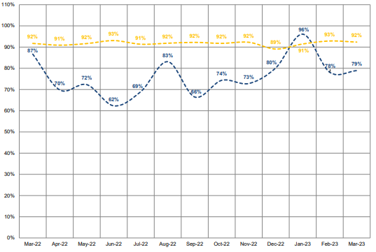
We constantly outperform the industry.
GVDM:
GVDM Collections is registered at the Council of Debt Collectors, Reg Nr: (0116834-19) and has a 200-seater capacity call center.
We currently have a 175 staff compliment with an average length of service more than 7 years.
75% of our staff are African, of which, 70% are female.
50% of our Call Center Management are African females.
Intecon Success Rate Per Stream
GVDM currently boasts on average a (pre legal) 83% success rate per month on instructions from customers.
Our success rate is on average 8% higher than the current industry average with a current turnaround of ± 120 days.

Slide 4
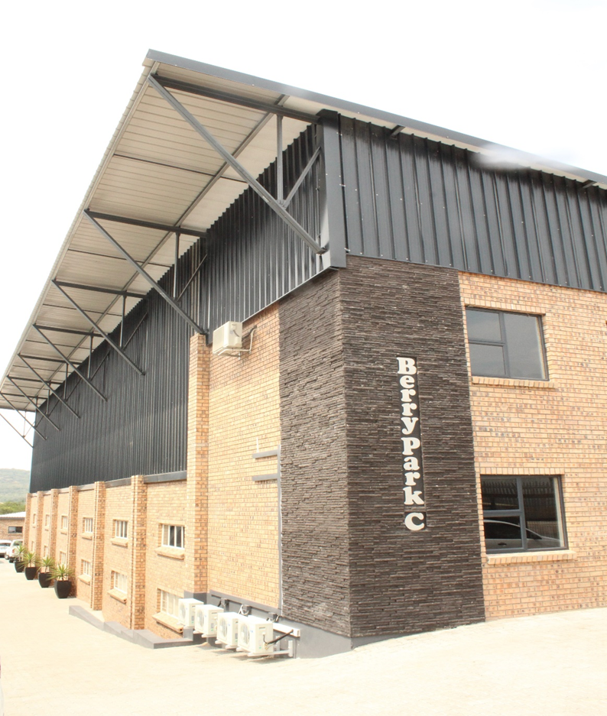

Our Goals:
To establish long term enduring relationships with our clients.
To remain relevant and deliver superior service, whilst maintaining strict ethical practices.
Customise solutions to our customers needs.
To remain amongst the top performing EDC’s on all the institution panels we perform on, for all our clients.
What Makes Us Different:
Our approach to staff, training and personal growth allows us to recruit and retain highly skilled, motivated staff.
Our “Can do” attitude with customers and the market allows us to outcompete the industry norms.
At GVDM we aspire to remain at the cutting edge of call center technology; and currently boast a 24-hour web-based portal allowing our customers to remain constantly abreast with performance statistics.
We provide cost effective end-to-end debt recovery solutions.
We are equally adept at managing high volume or specialized campaigns and are able to increase capacity with no disruption to the current business.
NTC:
National Trace & Collect originated in July 2017.
National Trace & Collect specializes in obtaining AC mandates on behalf of GVDM.
Council of Debt Collector's registration number: 01055478-17.
Consists of 41 national agents with ± 100 field consultants.
Field consultants have up to 10 years industry experience.
Approximately 100 terminals are allocated to field consultants nationwide.
Referral letters attached upon consent from some of
our current clients for your further perusal

Slide 5
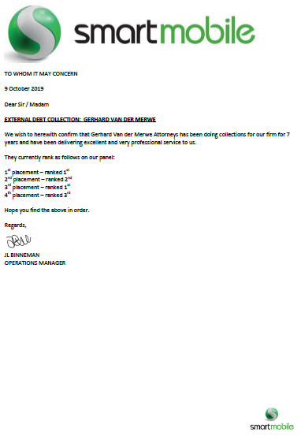

Slide 9
